Slide 1


Sun Kit Cheung (James Sun)
27/12/2023

Slide 2

Outline
Executive Summary
Introduction
Methodology
Results
Conclusion
Appendix

Slide 3
Executive Summary
Summary of methodologies
The methodology for this project involved the following steps:
Data collection: Data was collected from the public SpaceX API and SpaceX Wikipedia page.
Label creation: A new column called 'class' was created to classify successful landings.
Data exploration: SQL queries, visualization techniques, folium maps, and dashboards were used to explore the data.
Feature selection: Relevant columns were gathered to be used as features in the machine learning models.
Data preprocessing: Categorical variables were transformed into binary using one-hot encoding. The data was also standardized.
Model selection and parameter tuning: Four machine learning models were implemented - Logistic Regression, Support Vector Machine, Decision Tree Classifier, and K Nearest Neighbors. GridSearchCV was used to find the best parameters for each model.
Model evaluation: The accuracy score of each model was visualized to compare their performance.
Overall, the project involved data collection, preprocessing, model training, and evaluation to analyze and classify successful landings using machine learning techniques.
Summary of all results
In summary, all of the produced machine learning models showed similar results with an accuracy rate of over 80% (83.33%). However, it is worth noting that all models tended to over-predict successful landings. To improve model determination and accuracy, it is recommended to gather more data. Increasing the dataset size can help provide a more robust foundation for the models to learn from and make more accurate predictions.

Slide 4
Introduction
Project background and context
Since 1957, countries worldwide have been engaged in a competitive race to explore space and expand beyond Earth's limits. These endeavors involve launching satellites and conducting space exploration missions, which require substantial financial investments. On average, the cost of launching a space rocket amounts to around 165 million dollars. However, companies like SpaceX have revolutionized this industry by significantly reducing the cost to only 60 million dollars. This remarkable achievement is attributed to SpaceX's innovative and advanced technologies, particularly its ability to successfully recover and reuse the first stage of the rocket structure.
Problems you want to find answers
The problems we aim to find answers to are as follows:
Identify the main attributes or variables that contribute to the successful landings of SpaceX's rockets, particularly focusing on the safe return of the first stage.
Explore and analyze the launch process, including factors such as the payload mass of the rocket, launch location, and rocket orbit, among others.
Utilize data science methodologies provided by IBM to analyze and visualize the collected information.
Gain insights into the nature of the launch process and its impact on the success of rocket landings, ultimately contributing to a better understanding of SpaceX's achievements in the space race.

Slide 5

Section 1

Slide 6
Methodology
Executive Summary
Data collection methodology:
The data collection process involved utilizing the SpaceX REST API and performing web scraping on Wikipedia webpages. These two methods were employed to gather the necessary data for the project.
Perform data wrangling:
The collected data was preprocessed using Pandas and NumPy, incorporating several key techniques. These techniques included performing one-hot encoding to handle categorical variables, removing unnecessary columns from the dataset, as well as applying data normalization and standardization methods to ensure consistent scaling and prepare the data for further analysis.
Perform exploratory data analysis (EDA) using visualization and SQL
Perform interactive visual analytics using Folium and Plotly Dash
Perform predictive analysis using classification models
The process began with dividing the data into training and testing sets. Subsequently, hyperparameter tuning using Grid Search was employed to identify the optimal algorithm and parameter settings. Finally, the best algorithm and parameters were selected and adopted to deploy the model for the intended purpose.

Slide 7
Data Collection
Data collected from two main sources: SpaceX API: An open-source REST API that provides access to various data related to launches, rockets, cores, capsules, Starlink, launchpads, and landing pads. It offers a comprehensive source of information for SpaceX-related data.
Wikipedia: A freely available online encyclopaedia that relies on contributions from volunteers across the globe. It is hosted by the Wikimedia Foundation and serves as a valuable resource for a wide range of general knowledge and information.

Slide 8
Data Collection – SpaceX API
Request (using Space X APIs)
.JSON file + Lists(Launch Site, Booster Version, Payload Data)
Json_normalize to DataFrame data from JSON
Filter data to only include Falcon 9 launches
Replace missing PayloadMass values with mean
Data collection from SpaceX API:
Imported necessary libraries such as pandas, NumPy, and Request.
Established a URL GET request to the SpaceX API.
Received the data as a JSON file.
Converted the JSON file into a data frame.
Selected the required information, including geospatial info, rocket type, orbit, flight number, and more.
GitHub URL of the completed SpaceX API calls notebook: https://github.com/jamezun/IBM-Data-Science-Professional-Certificate/blob/main/week1/jupyter-labs-spacex-data-collection-api.ipynb

Slide 9
Data Collection - Scraping
Data collection from Wikipedia using web scraping:
Imported the necessary Python libraries, including BeautifulSoup and request.
Selected a specific Wikipedia webpage titled "SpaceX Falcon 9 First Stage Landing Prediction" as the data source.
Initiated an HTTP GET request to retrieve the webpage's content.
Received the response in a text format.
Utilized the BeautifulSoup library to effectively extract the desired tables and columns from the text response.
Converted the extracted data into a pandas data frame for further analysis and manipulation.
GitHub URL of the completed web scraping notebook: https://github.com/jamezun/IBM-Data-Science-Professional-Certificate/blob/main/week1/jupyter-labs-webscraping.ipynb
Request Wikipedia site
Find launch info html table
Cast dictionary to dataFrame by iterating table cells
BeautifulSoup html5lib Parser

Slide 10
Data Wrangling
In this stage, we performed exploratory data analysis on our collected data. We imported pandas and NumPy libraries and loaded the data. The goal was to clean the data and select relevant features for training a machine learning model.
We created a training label based on landing outcomes, where a successful landing was represented as 1 and a failure as 0. The outcome column consisted of two components: 'Mission Outcome' and 'Landing Location'.
To create a new training label column called 'class', we assigned a value of 1 if the 'Mission Outcome' was True and 0 for all other cases. The mapping for the values was as follows:
True ASDS, True RTLS, and True Ocean were set to 1.
None None, False ASDS, None ASDS, False Ocean, and False RTLS were set to 0.
GitHub URL of the completed data wrangling: https://github.com/jamezun/IBM-Data-Science-Professional-Certificate/blob/main/week1/labs-jupyter-spacex-Data%20wrangling.ipynb
Loading of collected dataset
Identification and calculating the percentage of the missing values in each attribute
Identification which columns are numerical and categorical
Calculation the number of launches on each site
Calculation the number and occurrence of each orbit
Creation of landing outcome label from Outcome column
Determination of the success rate of returning the first stage of the rocket

Slide 11
EDA with Data Visualization
Exploratory Data Analysis (EDA) process:
Utilized seaborn and matplotlib libraries to visualize and analyze the data.
Explored the correlation between features and the target variable.
Performed feature engineering by converting categorical features into dummy values.
Variables analyzed in EDA:
Flight Number, Payload Mass, Launch Site, Orbit, Class, and Year.
Plots used for visualization:
Flight Number vs. Payload Mass, Flight Number vs. Launch Site, Payload Mass vs. Launch Site, Orbit vs. Success Rate, Flight Number vs. Orbit, Payload vs. Orbit, and Success Yearly Trend.
Purpose of the plotted charts:
Scatter plots: To examine relationships between Flight Number and Payload Mass, Flight Number and Launch Site, and Payload Mass and Launch Site.
Line charts: To observe trends in Success Rate over different Orbits and Years.
Bar plots: To compare the distribution of variables and analyze categorical features.
The charts were plotted to gain insights into the relationships and patterns within the data, determine if any significant correlations exist, and identify variables that could be useful in training the machine learning model. Visualizations help in understanding the data more intuitively and aid in making informed decisions during the model development process.
GitHub URL of the EDA with data visualization notebook: https://github.com/jamezun/IBM-Data-Science-Professional-Certificate/blob/main/week2/jupyter-labs-eda-dataviz.ipynb.jupyterlite.ipynb

Slide 12
EDA with SQL
Loaded data set into the database.
Queried using the SQL Python integration.
Queries were made to get a better understanding of the dataset.
Queried information about launch site names, mission outcomes, various pay load sizes of customers and booster versions, and landing outcomes using subquery, sorting and setting ranges etc.
GitHub URL of the completed EDA with SQL notebook: https://github.com/jamezun/IBM-Data-Science-Professional-Certificate/blob/main/week2/jupyter-labs-eda-sql-coursera_sqllite.ipynb

Slide 13
Build an Interactive Map with Folium
In this stage we summarized using map objects such as markers, circles, lines, etc. and added to a folium map
In our interactive map, we marked four different sites related to Falcon 9 rocket launches by drawing circles. Each circle represented specific information about the launches.
To indicate the success or failure of the first stage rocket return, we placed markers on the same sites using marker objects.
Additionally, we calculated the distances between the launch site (CCAFS LC 40) and three nearby locations: the closest city, the coastline, and the highway. These distances were represented by drawing polylines using PolyLine objects.
GitHub URL of the completed interactive map with Folium map: https://github.com/jamezun/IBM-Data-Science-Professional-Certificate/blob/main/week3/lab_jupyter_launch_site_location.jupyterlite.ipynb

Slide 14
Build a Dashboard with Plotly Dash
The dashboard consists of a pie chart and a scatter plot.
The pie chart provides two options for selection. It can display the distribution of successful landings across all launch sites or show the success rates for each individual launch site.
The scatter plot has two inputs that can be adjusted. It allows selection between viewing data for all launch sites or for a specific individual site. Additionally, there is a slider to adjust the payload mass, ranging from 0 to 10,000 kg.
The purpose of the pie chart is to visualize the success rate of each launch site. On the other hand, the scatter plot provides insights into how success rates vary across launch sites, payload mass, and booster version category.
GitHub URL of the completed Plotly Dash lab: https://github.com/jamezun/IBM-Data-Science-Professional-Certificate/blob/main/week3/spacex_dash_app.py

Slide 15
Predictive Analysis (Classification)
Importing the required python libraries
Loading the cleaned data
Standardizing the data
Splitting the data into Test/Train datasets
Initializing classification algorithms
Using Grid Search technique
Using evaluation techniques
Identifying the best model and parameters
The stages of the machine learning process are as follows:
Importing the necessary libraries.
Loading the cleaned data.
Standardizing the data to avoid bias.
Splitting the data into 20% for testing and 80% for training.
Initializing four different classification algorithms:
Logistic Regression (LR)
Support Vector Machine (SVM)
Decision Tree (DT)
K-nearest neighbors (KNN)
Utilizing the Grid Search technique to identify the best parameters for each algorithm.
Evaluating the models using various techniques including:
Confusion matrix
F1 score
Jaccard score These evaluation metrics are employed to determine the best model among the mentioned algorithms.
These steps encompass the process of implementing and assessing different classification models to identify the most effective one for the given problem.
GitHub URL of the completed predictive analysis lab: https://github.com/jamezun/IBM-Data-Science-Professional-Certificate/blob/main/week4/SpaceX_Machine_Learning_Prediction_Part_5.jupyterlite.ipynb

Slide 16
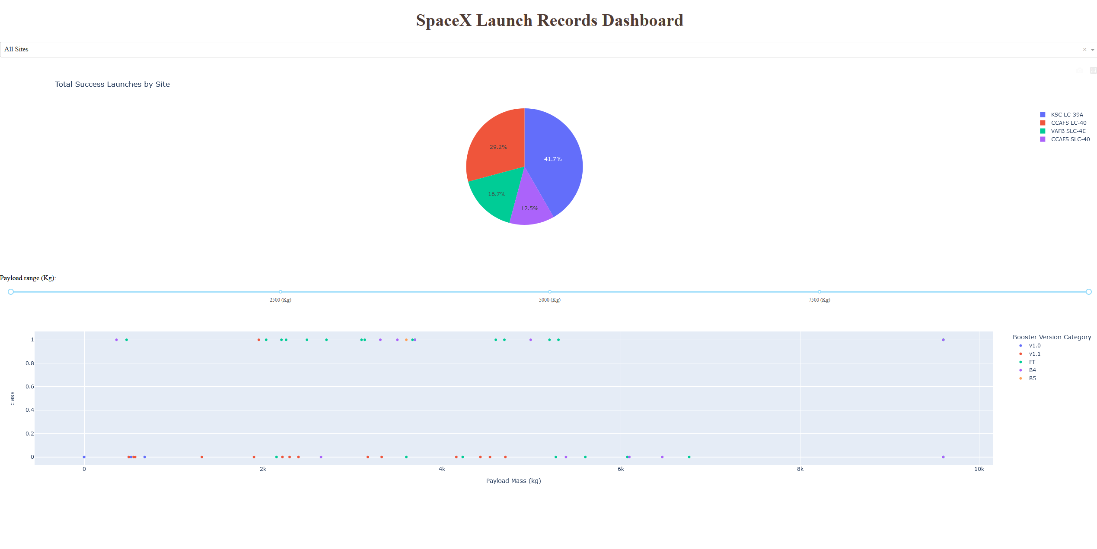
Results
Exploratory data analysis results
- different launch sites have different success rates
- using onehotencoder to obtain encoded features
Interactive analytics demo in screenshots
Predictive analysis results indicated decision tree model yield the best result with accuracy up to 94%

Slide 17

Section 2

Slide 18
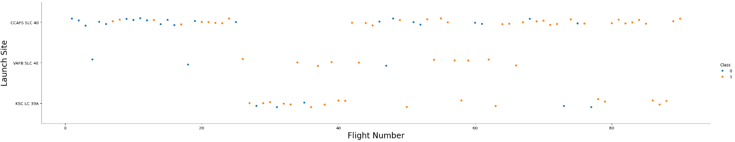
Flight Number vs. Launch Site
Scatter plot of Flight Number vs. Launch Site
Orange points indicates successful launch while blue points indicates unsuccessful launch.
The graphic indicates a noticeable improvement in the success rate over time, as seen in the increasing Flight Number.
There seems to be a significant breakthrough around 20th flight, which resulted in a substantial increase in the success rate.
Moreover, it is apparent that CCAFS is the primary launch site, as it has the highest launch volume compared to other sites.

Slide 19
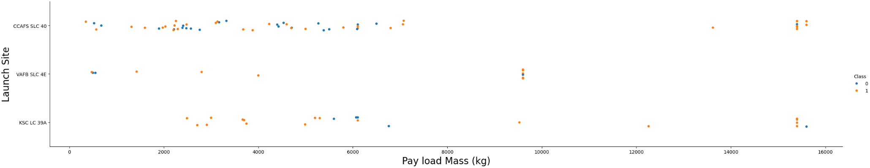
Payload vs. Launch Site
Scatter plot of Payload vs. Launch Site
Orange points indicates successful launch while blue points indicates unsuccessful launch.
The analysis suggests that the majority of payload masses fall within the range of 0-6000 kg.
Additionally, it is observed that different launch sites have varying preferences for payload mass, indicating that each site may have its own specific requirements or limitations when it comes to the payloads they handle.

Slide 20
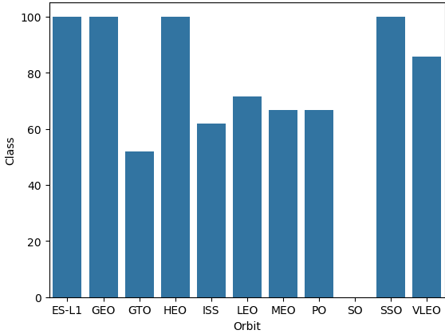
Success Rate vs. Orbit Type
Bar chart for the success rate of each orbit type
ES-L1, GEO, HEO have 100% success rate (sample sizes in parenthesis) SSO has 100% success rate
VLEO has decent success rate and attempts
SO has 0% success rate
GTO has the around 50% success rate but largest sample

Slide 21
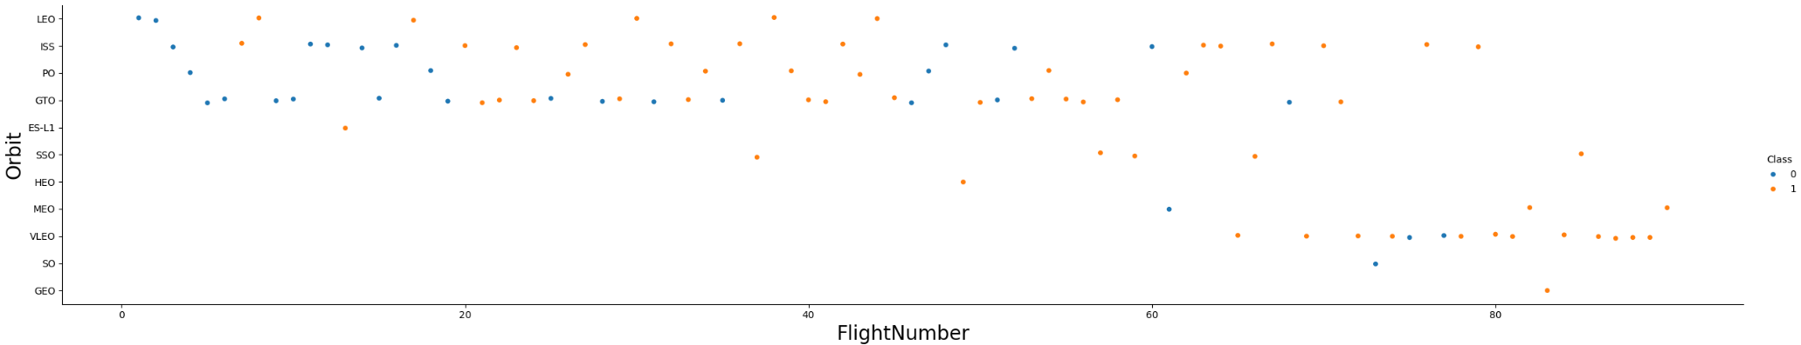
Flight Number vs. Orbit Type
Scatter point of Flight number vs. Orbit type
Orange points indicates successful launch while blue points indicates unsuccessful launch.
n the LEO (Low Earth Orbit), the success rate appears to be influenced by the number of flights.
There is no noticeable relationship between the flight number and outcomes in the GTO (Geostationary Transfer Orbit).
Launch orbit preferences have changed over the flight number.
The launch outcome seems to be correlated with these preferences.
Initially, SpaceX focused on LEO orbits, which showed moderate success.
In recent launches, SpaceX has shifted back to VLEO (Very Low Earth Orbit) or Sun-synchronous orbits.
SpaceX seems to perform better in lower orbits or Sun-synchronous orbits.

Slide 22
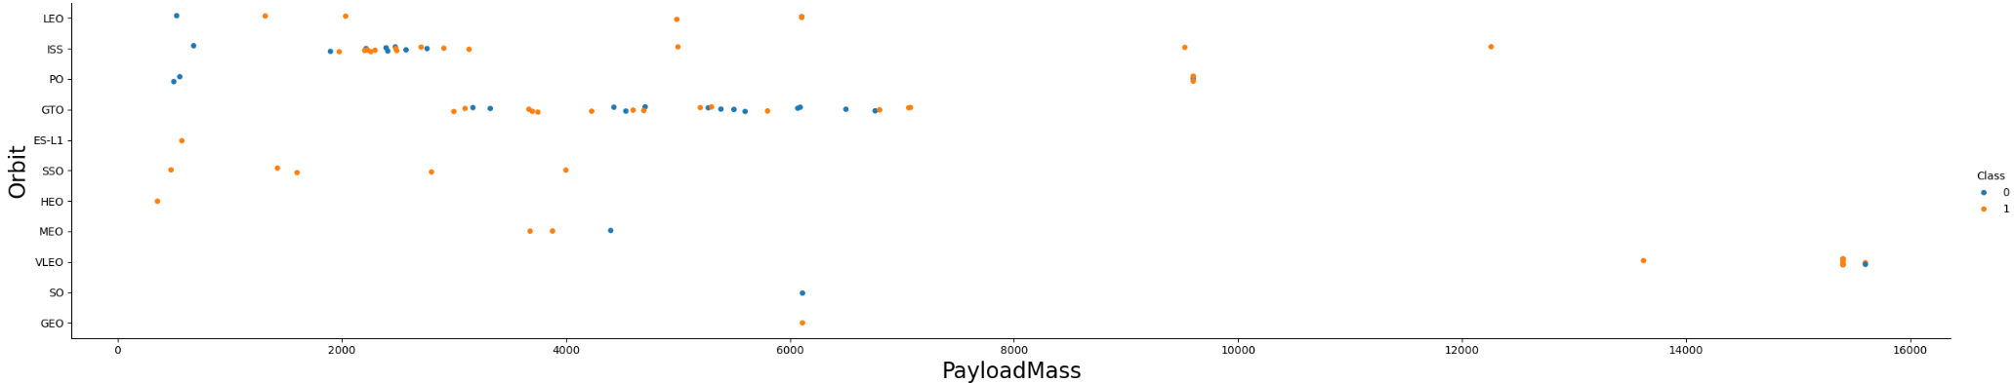
Payload vs. Orbit Type
Scatter point of payload vs. orbit type
Orange points indicates successful launch while blue points indicates unsuccessful launch.
Payload mass do not seems to corelate to the orbit type
SSO has good outcomes no matter what payload mass

Slide 23
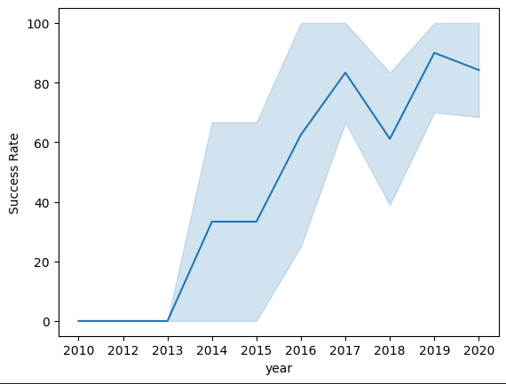
Launch Success Yearly Trend
Line chart of yearly average success rate
Success generally increases over time since 2013 with a slight drop in 2018
Success in recent years at approximately 80%

Slide 24
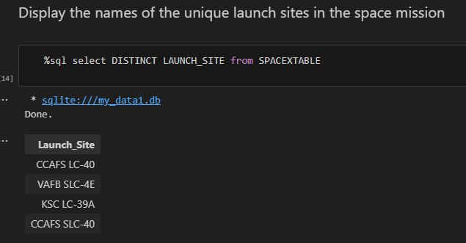
All Launch Site Names
The names of the unique launch sites
As shown above we have four distinct sites for rockets launches listed in the table above.

Slide 25
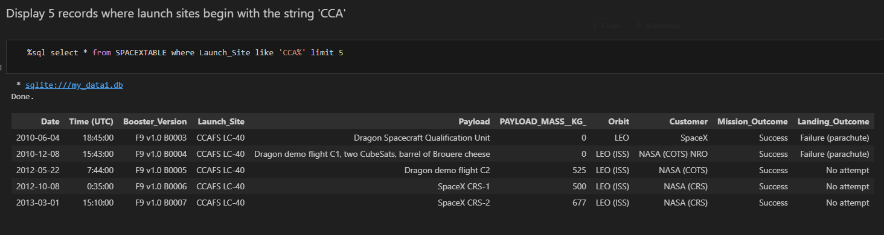
Launch Site Names Begin with 'CCA'
5 records where launch sites begin with `CCA`
First five entries with Launch Site name beginning with CCA in the database.

Slide 26
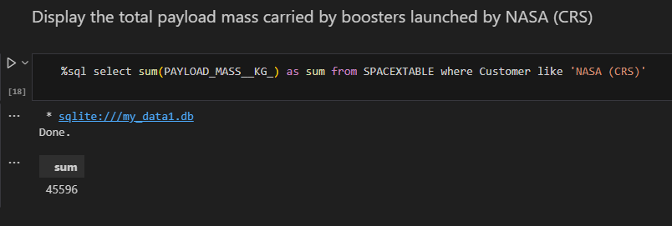
Total Payload Mass
The total payload carried by boosters from NASA
NASA, utilizing SpaceX rockets, has successfully transported a total payload of 45596 kilograms to outer space.

Slide 27
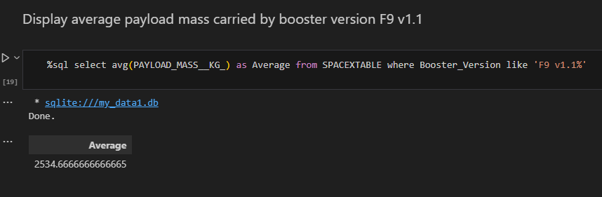
Average Payload Mass by F9 v1.1
The average payload mass carried by booster version F9 v1.1
The average payload mass carried by booster version F9 v1.1 is 2534.6 kg

Slide 28
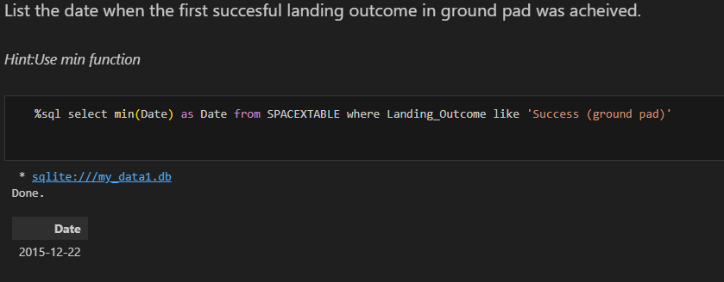
First Successful Ground Landing Date
The dates of the first successful landing outcome on ground pad
The date is 2015-12-22.

Slide 29
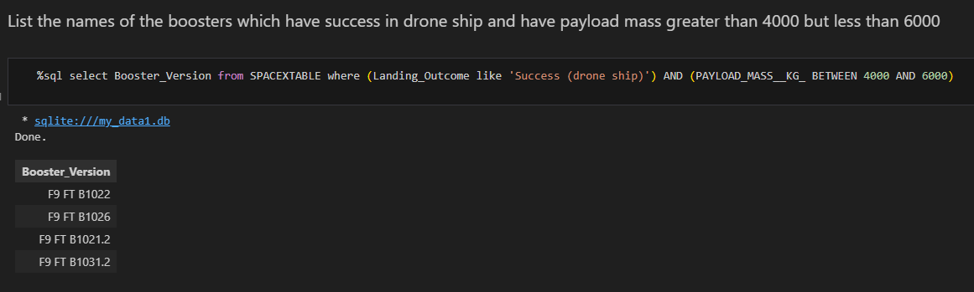
Successful Drone Ship Landing with Payload between 4000 and 6000
List the names of boosters which have successfully landed on drone ship and had payload mass greater than 4000 but less than 6000
This query returns the four booster versions that had successful drone ship landings with a payload mass between 4000 and 6000.

Slide 30
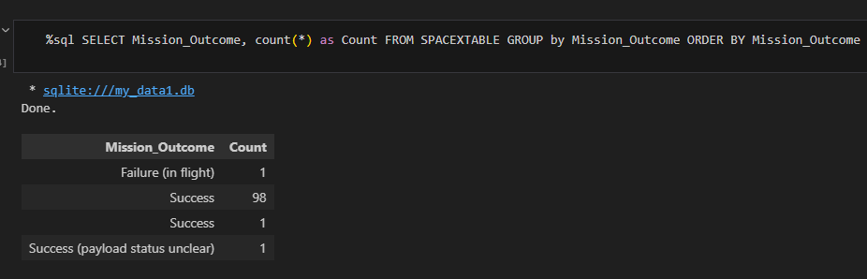
Total Number of Successful and Failure Mission Outcomes
Calculate the total number of successful and failure mission outcomes
As illustrated above, success outcome takes approximately 99% while there are only one success with payload status unclear

Slide 31
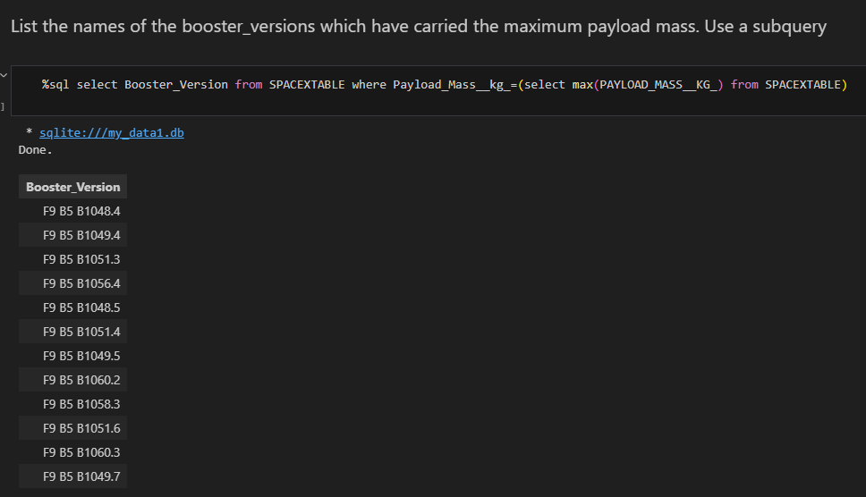
Boosters Carried Maximum Payload
The names of the booster which have carried the maximum payload mass
F9 B5 B1048.4 is the first result and reaches to version F9 B5 B1049.7

Slide 32
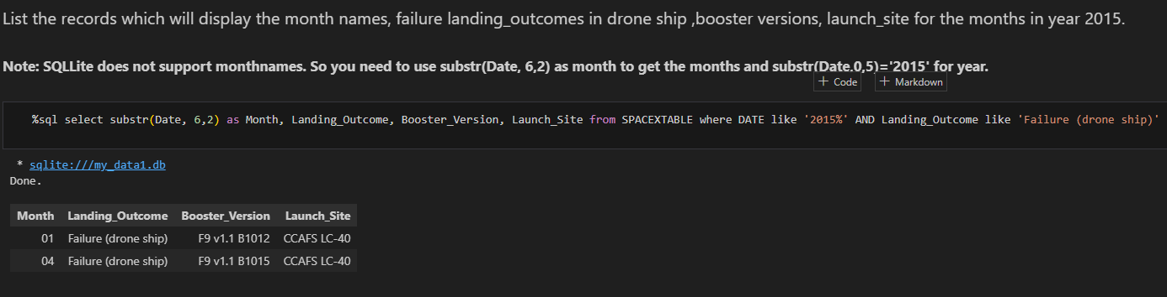
2015 Launch Records
List the failed landing_outcomes in drone ship, their booster versions, and launch site names for in year 2015
The failed outcome occurred in January and April with version F9 v1.1 B1015 in launch site CCAFS LC-40

Slide 33
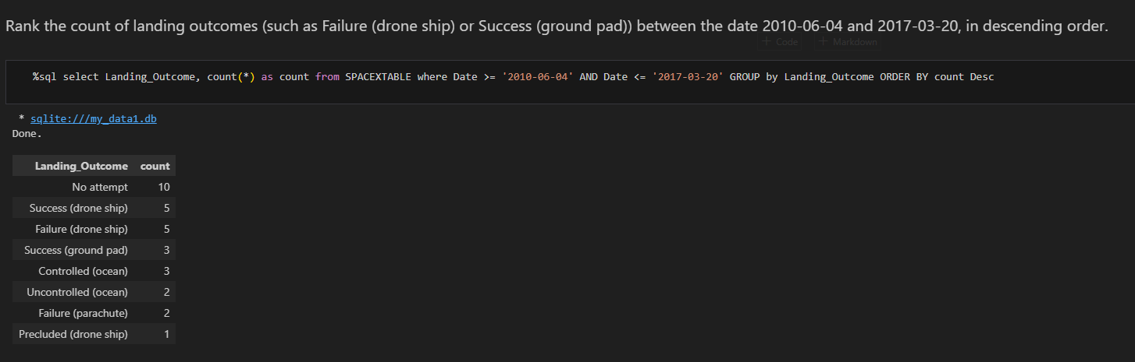
Rank Landing Outcomes Between 2010-06-04 and 2017-03-20
Rank the count of landing outcomes (such as Failure (drone ship) or Success (ground pad)) between the date 2010-06-04 and 2017-03-20, in descending order
The outcome is listed out with no attempt has the highest count and precluded (drone ship) the lowest

Slide 34

Section 3

Slide 35
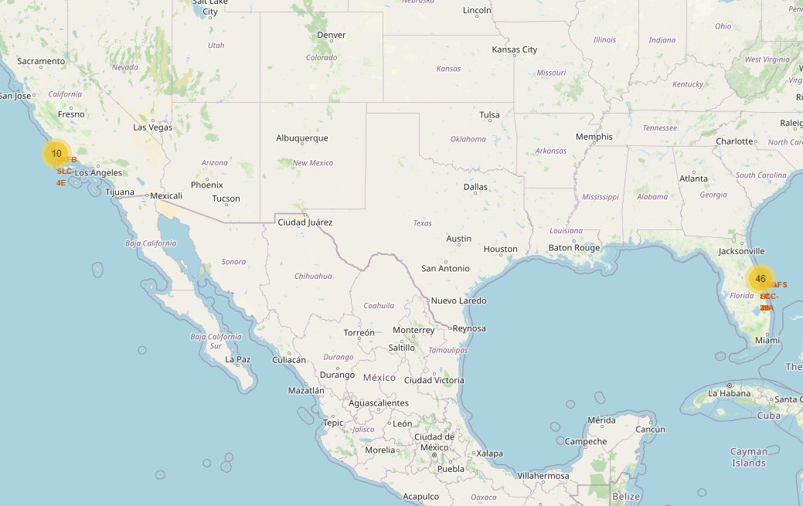
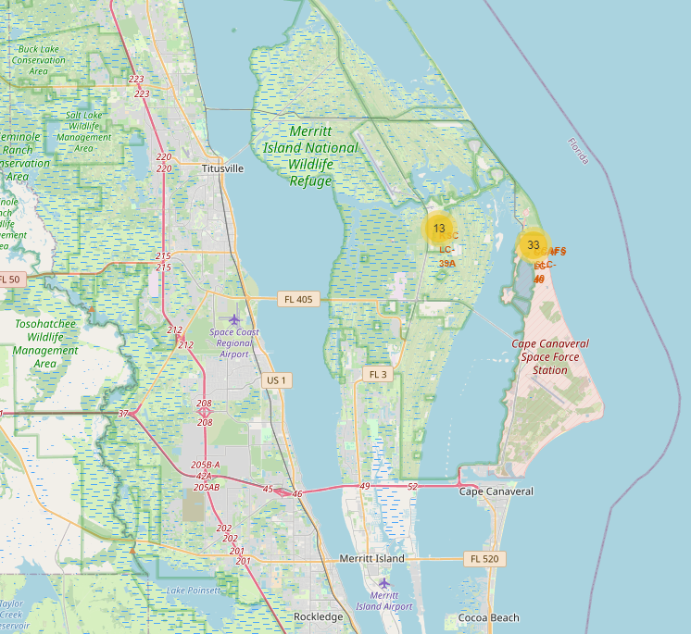
Launch Site Locations
Both map indicate the launch sites are next to the coast line while the launch sites are distributed in two states California and Florida.

Slide 36
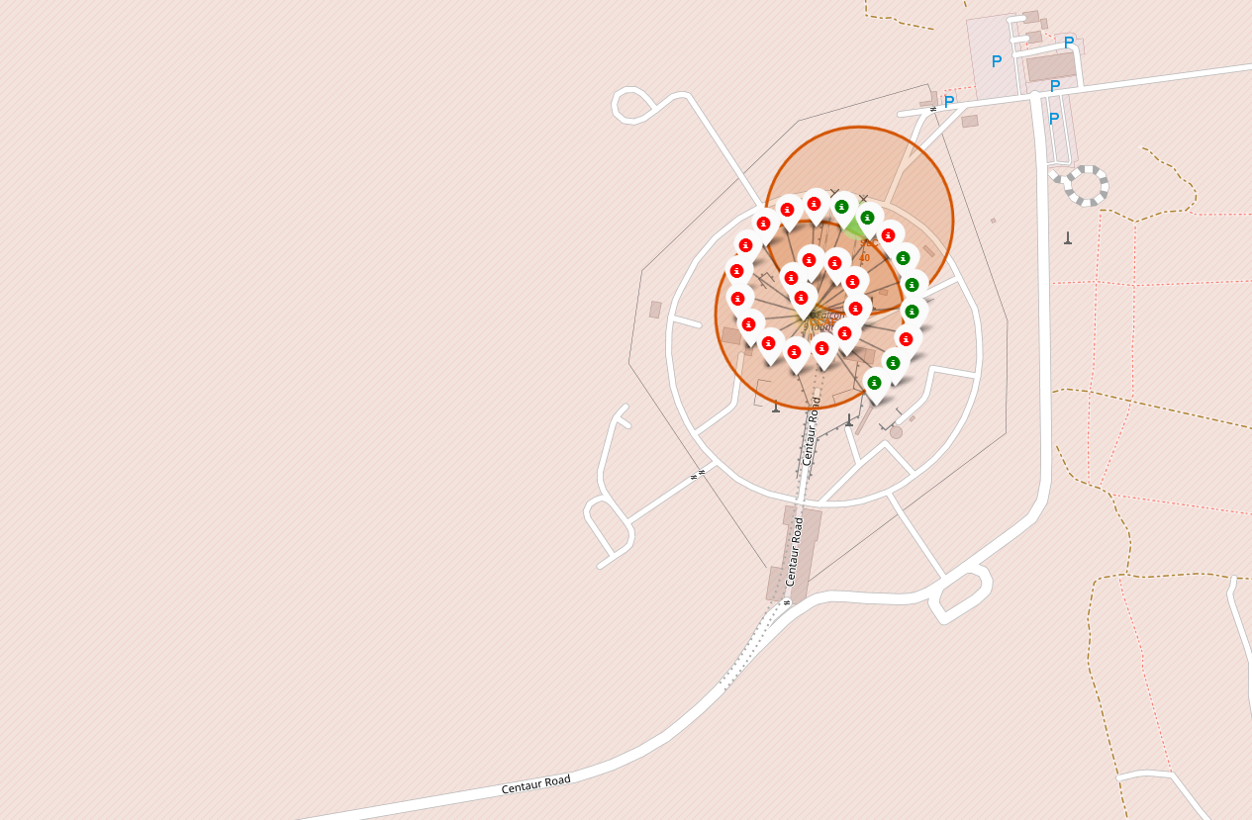
Color Coded Launch Markers
The color-labeled markers in marker clusters indicate which launch sites have relatively high success rates while green means successful and red means failed.

Slide 37
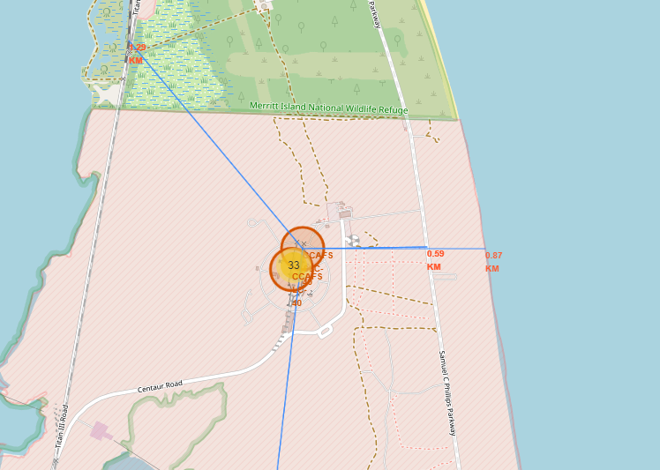
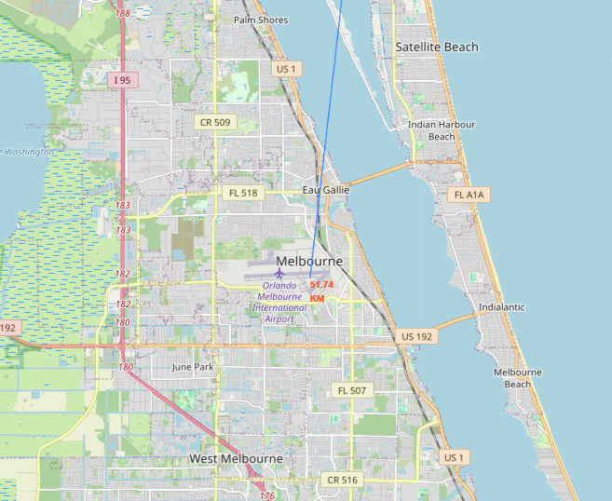
Key Location Proximities
The distances between the launch site (CCAFS LC-40) to its proximities:
Highway: 0.59KM
Coastline: 0.87KM
Train station: 1.29KM
Closest city: 57.74KIM

Slide 38

Section 4

Slide 39
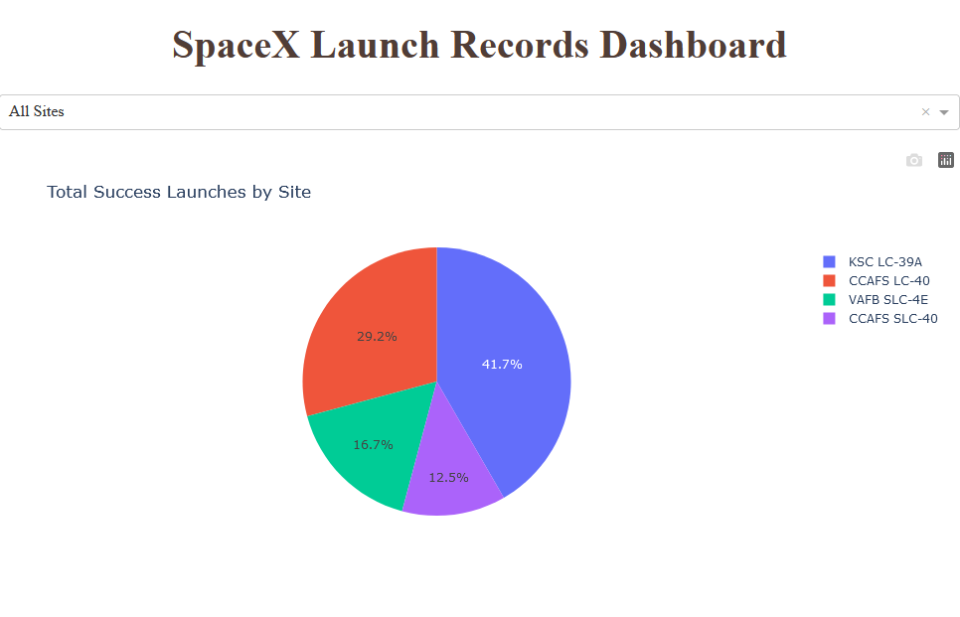
Dashboard: Launch success count for all sites
The chart illustrates the success rates of each individual site in relation to first stage return.
• The top-performing site, KSC LC 39A, boasts a 41.7% success rate in terms of total successful rocket launches among all sites. • Conversely, CCAFS SLC 40 is the site with the lowest success rate for rocket launches, standing at a mere 12.5%.

Slide 40
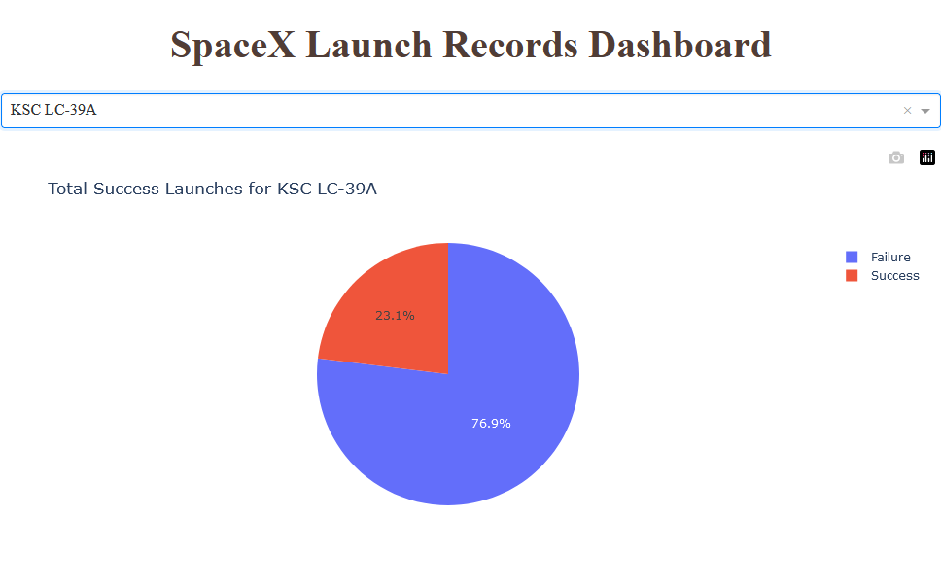
Highest Success Rate Launch Site
KSC LC-39A has the highest success rate of 76.9% with 10 successful landings with 3 failed landings amount to 23.1%.

Slide 41
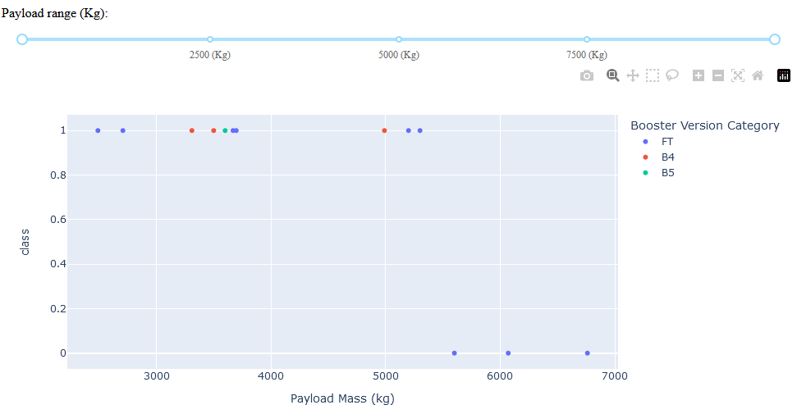
Payload Mass vs. Success vs. Booster Version Category
The scatter plot displayed is an interactive visualization depicting the correlation between payload mass and launch outcomes. From the plot, we can deduce that there is a higher likelihood of success for payload masses less than 4000 kg, especially when considering the success rate per booster version.

Slide 42

Section 5

Slide 43
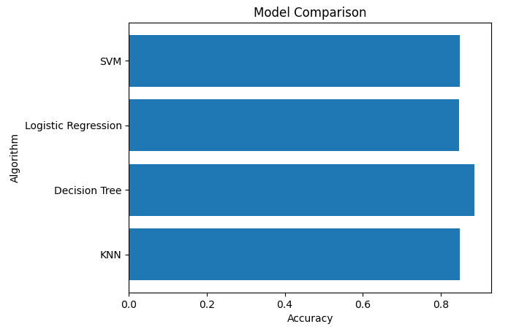
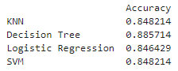
Classification Accuracy
Decision Tree has the best performance compared to other models with accuracy reach up to 88.5%.

Slide 44
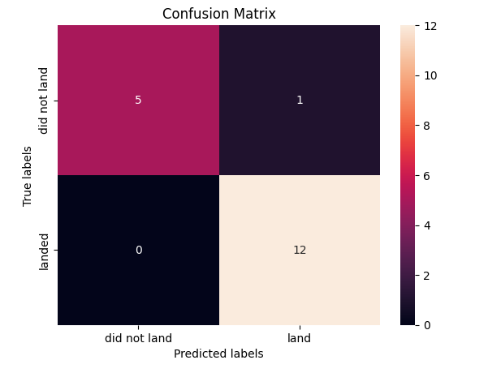
Confusion Matrix
Decision Tree confusion matrix and results:
•True Positive = 12
•False Positive = 0
•True Negative = 5
•False Negative = 1

Slide 45
Conclusions
Developed a machine learning model for Space Y to predict the successful landing of Stage 1, aiming to save approximately $100 million USD.
Utilized data from a public SpaceX API and web scraping SpaceX Wikipedia page.
Created data labels and stored the data into a DB2 SQL database.
Developed a visualization dashboard for data exploration.
Achieved a machine learning model accuracy of 88.5%.
The model can be utilized by Allon Mask of SpaceY to accurately predict whether a launch will have a successful Stage 1 landing, aiding in decision-making regarding the launch.
Collecting more data is recommended to improve the accuracy of the model and determine the best machine learning approach.
Attributes such as proximity to a highway, railway, and coastline in SpaceX Falcon9 launch sites contribute to transportation cost reduction.
Further investigation is needed to gain deeper insights into the factors influencing successful first stage returns.
SpaceX's success rate has increased over the years, with KSC LC - 39A site having the highest success rate.
The orbit and booster version have an impact on the success rate of SpaceX launches.

Slide 46
Appendix
Github url: https://github.com/jamezun/IBM-Data-Science-Professional-Certificate/tree/main

Slide 47


